Slide 1

Ethics, Bias, and Fairness Part II
Rayid Ghani and Kit Rodolfa

Slide 2
Reminders
This week:
project check-ins on Wednesday/Thursday
Coming up next week:
Tuesday: update assignment – bias and fairness
Readings for Tuesday: causality and field validation
Project presentations on Thursday

Slide 3
Project Presentations
https://canvas.cmu.edu/courses/31334/assignments/515887

Slide 4
Plan for the week
What you should be working on with your team this week (and next week)
Finalize model grid/runs
Review entire pipeline – sanity checks and completeness (cohort, labels, features, grid, etc.)
Model fairness metrics and evaluation
Review what’s needed for final presentation and report

Slide 5
Scope
Data
Exploration
Modeling
Get Data
Store Data
Link Data
Rows
Features
Labels
Model Selection
Train-Test Splits
Performance Metrics
Model Interpretation
Entities
temporal
Spatial
…
Models
Dealing with Bias and Fairness
Field Trial Design
Deployment
Monitoring
Goals, Actions, Data, Analysis, Ethics

Slide 6
The focus should not just be on making the ML model fair but rather on making the overall system and outcomes fair
Define (desired fairness or equity goals)
Understand (root causes of bias)
Improve (fairness of AI systems)
Measure and Detect (bias)
Mitigate (the impact through adjusting interventions)
Monitor & Evaluate

Slide 7
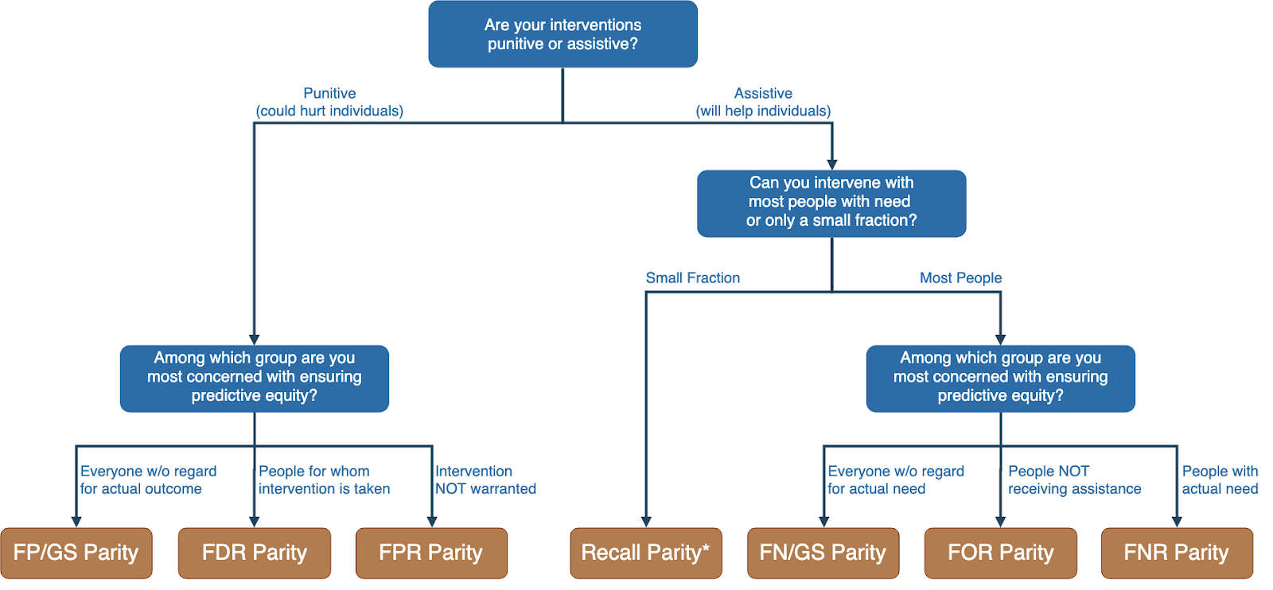
Translating policy goals to fairness metrics

Slide 8
Is the fairness tree “the answer”?

Slide 9
Is the fairness tree “the answer”?
No… but it’s intended as a starting point to help guide a conversation between ML experts, policy makers, and those affected by the decisions.
Ultimately, the choice of fairness metric(s) is highly dependent on context and stakeholder values.

Slide 10
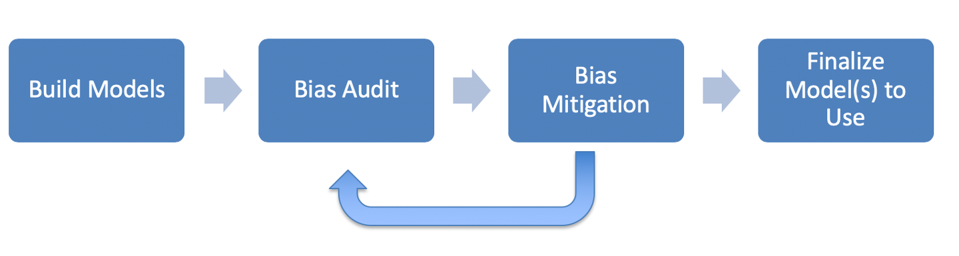
ML Fairness Workflow

Slide 11
How can we reduce bias in ML models?
Fix the world
Pre-Processing: Fix the input data
Remove sensitive attributes (and correlated ones)
Resample and/or reweight protected groups
In-Processing: Optimize for fairness in model training
Post-Processing
Choose fair models during model selection
Post-hoc adjustments to ‘de-bias’ model scores

Slide 12
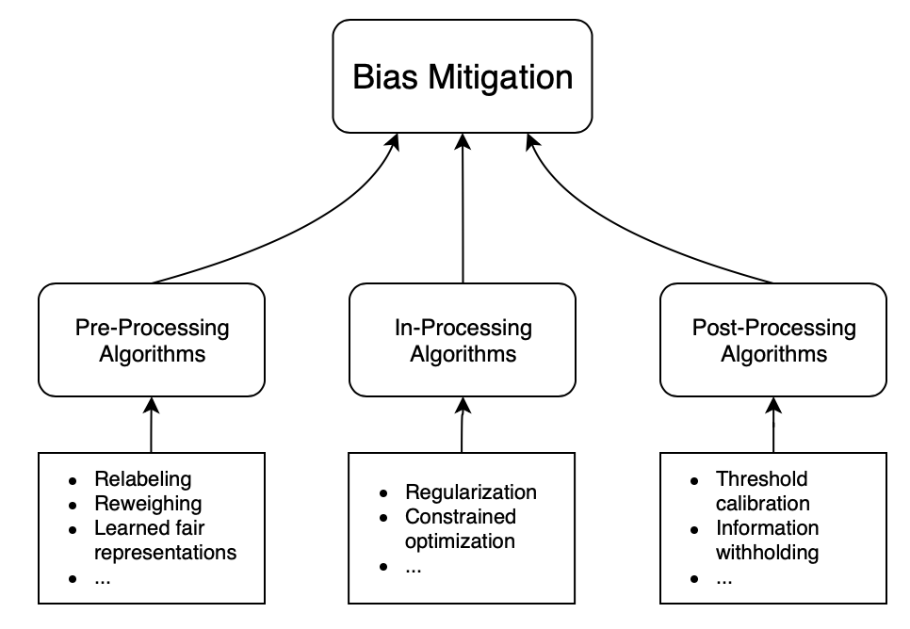
How can we reduce bias in ML models?

Slide 13
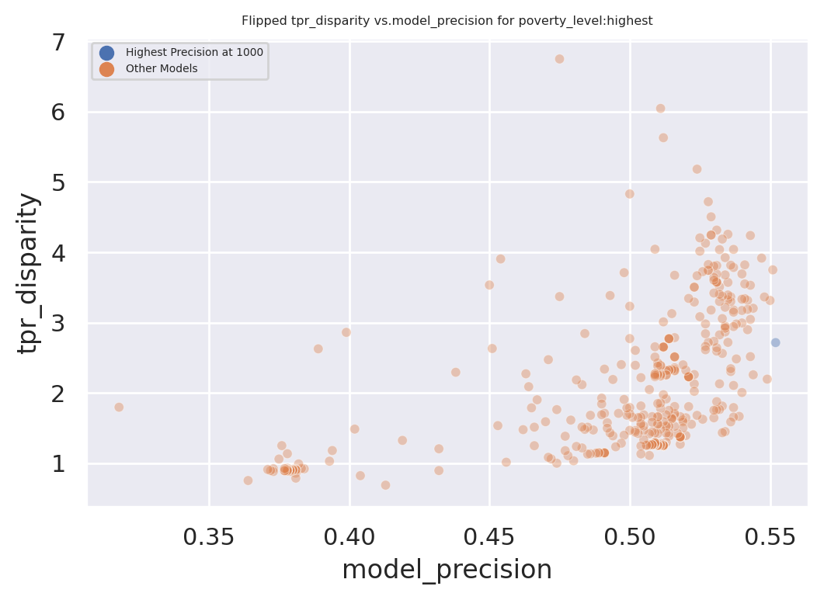
Exploring Trade-Offs
Each point is a different
model specification
Disparity
Precision@k

Slide 14
Exploring Trade-Offs
Each point is a different
model specification
Points further to the right
are more accurate
Disparity
Precision@k

Slide 15
Exploring Trade-Offs
Each point is a different
model specification
Points further to the right
are more accurate
Points closer to 1 on the
y-axis are more fair
Disparity
Precision@k

Slide 16
Exploring Trade-Offs
Disparity
“Best” model just based
on top k precision
Precision@k

Slide 17
Exploring Trade-Offs
Disparity
Pareto Frontier
Precision@k

Slide 18
Exploring Trade-Offs
Disparity
Our hope:
Fairness-improving
methods can expand this
frontier by adding new
points
Precision@k

Slide 19
Calculating Fairness Metrics for Your Models: aequitas
Triage can calculate various fairness metrics and disparities automatically for you using the aequitas bias audit tool
Specify a bias_audit_config in your triage config
Re-run your models using replace=False
Results can be found in test_results.aequitas

Slide 20
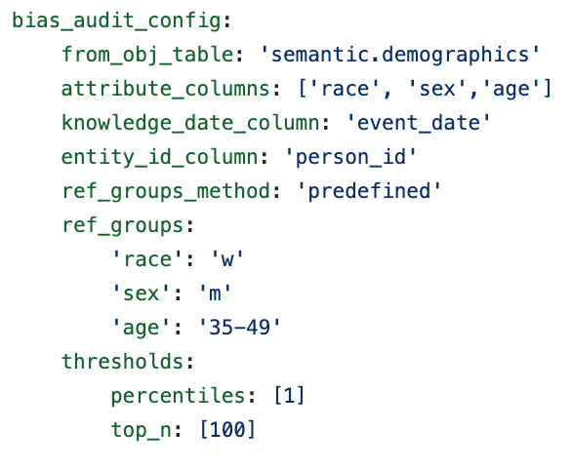
Calculating Fairness Metrics for Your Models: aequitas

Slide 21
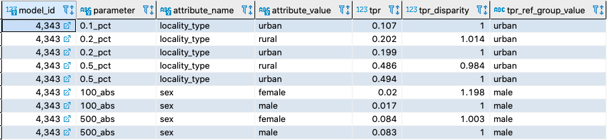
Calculating Fairness Metrics for Your Models: aequitas

Slide 22
Reminders
This week:
No class / project check-ins on Wednesday/Thursday
Coming up next week:
Monday: update assignment – bias and fairness
Readings for Tuesday: causality and field validation
Project presentations on Wednesday

Slide 23
Appendix

Slide 24
Legal and Social Principles
Choices about fairness and equity are implicit in any decision process but being made explicit by the growing use of algorithmic decision support.

Slide 25
Legal and Social Principles
Choices about fairness and equity are implicit in any decision process but being made explicit by the growing use of algorithmic decision support. What implicit choices about fairness are encoded when we say…
Beyond a reasonable doubt? (e.g., criminal court)
The preponderance of evidence? (e.g., civil court)
Probable cause? (e.g., indictment by grand jury)
Innocent until proven guilty?

Slide 26
Legal Perspectives and Challenges
Title VII of US Civil Rights Act – Job Discrimination
Disparate Treatment (intentional discrimination)
Disparate Impact (regardless of intention)
14th Amendment
Equal Protection (under laws and government actions)
“Strict Scrutiny” Standard: compelling state interest, narrowly tailored, and least restrictive means
Notes:
14th Amendment often interpreted to prohibit racial classification in most cases (that is, taking race into account in state decision-making) as well as racial intentions/discriminatory purpose

Slide 27
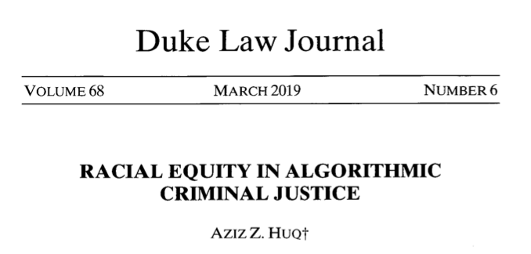
Legal Perspectives and Challenges

Slide 28
Legal Perspectives and Challenges
What Challenges Does Huq Identify Applying Current Legal Standards to Algorithmic Decision Making?

Slide 29
Legal Perspectives and Challenges
What Challenges Does Huq Identify Applying Current Legal Standards to Algorithmic Decision Making?
Expanded scale and reach of state power
Durability of errors – need for special skills to update/fix problems
What does “discriminatory intent” mean in this context?
Unclear how to apply “anticlassification” standard of equal protection

Slide 30
Legal Perspectives and Challenges
Difficulties with Equal Protection’s “Anticlassification” Standard:
Simply omitting race as a feature doesn’t ensure an algorithm is “colorblind” – too much correlated information in other features
Accounting for race may in fact be needed to decrease disparities

Slide 31
Legal Perspectives and Challenges
Drug Possession Rates
 | Black | White
Baseball Cap | 0% | 100%
No Cap | 2% | 2%

Slide 32
Legal Perspectives and Challenges
Drug Possession Rates
 | Black (25% of Pop.) | White (75% of Pop.)
Baseball Cap | 0% | 100%
No Cap | 2% | 2%
Race-Blind Policy:
75% Precision
Many Needless Searches of Minorities

Slide 33
Legal Perspectives and Challenges
Drug Possession Rates
 | Black (25% of Pop.) | White (75% of Pop.)
Baseball Cap | 0% | 100%
No Cap | 2% | 2%
Race-Aware Policy:
100% Precision
No Needless Searches of Minorities

Slide 34
Legal Perspectives and Challenges
How does Huq suggest modifying our criteria for assessing discrimination in this new context?

Slide 35
Legal Perspectives and Challenges
“Rather than asking about abstract definitions of fairness, a criminal justice algorithm should be evaluated in terms of its long-term, dynamic effects on racial stratification… [and] focus on the net burden thereby placed on the racial minority.”

Slide 36
Three Concepts of Fairness in ML
We’ve focused here on the concept of group fairness – balancing aggregate metrics across groups
Some also study the concept of individual fairness – that similar individuals should be treated similarly
An important related line of work concerns counterfactual fairness – how would your prediction if you were a member of a different group?

Slide 37
Practical Challenges with Individual Fairness
How do you measure “similarity”? Over what distance metric and what features?
Individual fairness doesn’t guarantee group fairness (but also vice-versa)
In the light of existing or historical discrimination, the protected attribute / group membership might be an important measure of dissimilarity in itself

Slide 38
Where does this leave us?
What can we do to understand bias and improve fairness of our systems?
Bias and equity audits
Try to fix the input data
Optimize for fairness in model training
Choose fair models during model selection
Post-hoc adjustments to de-bias model scores
Measure relative effectiveness of interventions across groups and develop better-tailored interventions

Slide 39
Bias and Fairness Workflow
Define
Understand (root causes)
Improve (fairness)
Measure/ Detect (bias)
Mitigate (the impact)
Monitor &
Evaluate
- Metrics(s)
- Groups
- Audit model(s) for bias across metric(s) and groups
Data
ML pipeline components
Actions
Pre-Processing
Modeling (e.g. regularization)
Post-processing
Design appropriate actions

Slide 40
Bias and Fairness Workflow
Define
Understand (root causes)
Improve (fairness)
Measure/ Detect (bias)
Mitigate (the impact)
Monitor &
Evaluate
- Metrics(s)
- Groups
- Audit model(s) for bias across metric(s) and groups
Data
ML pipeline components
Actions
Pre-Processing
Modeling (e.g. regularization)
Post-processing
Design appropriate actions

Slide 41
Many Bias Measures: How do we select what we care about?

Slide 42
Translating policy goals to fairness metrics

Slide 43
Bias and Fairness Workflow
Define
Understand (root causes)
Improve (fairness)
Measure/ Detect (bias)
Mitigate (the impact)
Monitor &
Evaluate
- Metrics(s)
- Groups
- Audit model(s) for bias across metric(s) and groups
Data
ML pipeline components
Actions
Pre-Processing
Modeling (e.g. regularization)
Post-processing
Design appropriate actions

Slide 44

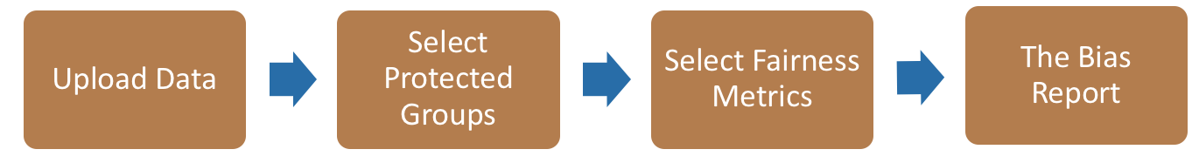
Bias Audit Flow
Race
Sex
Age
Equal False
Omission Rate
Risk Score and Outcomes

Slide 45
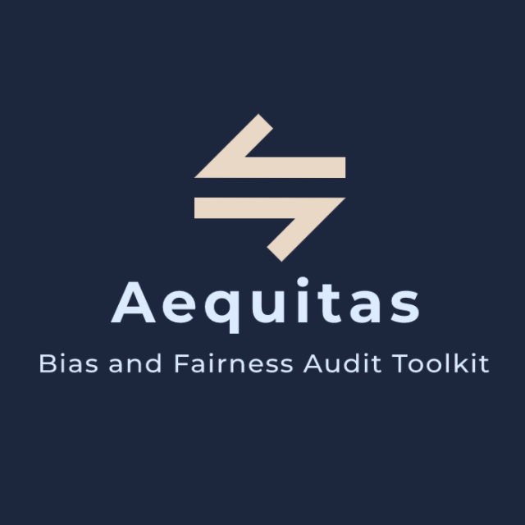
Bias Audit
http://www.datasciencepublicpolicy.org/aequitas/

Slide 46
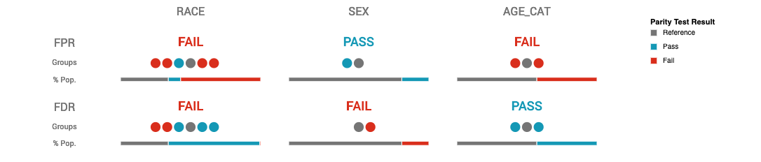
Auditing COMPAS Disparities

Slide 47
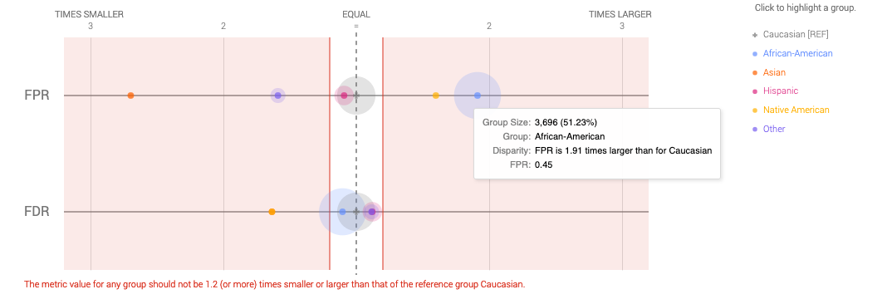
Auditing COMPAS Disparities

Slide 48
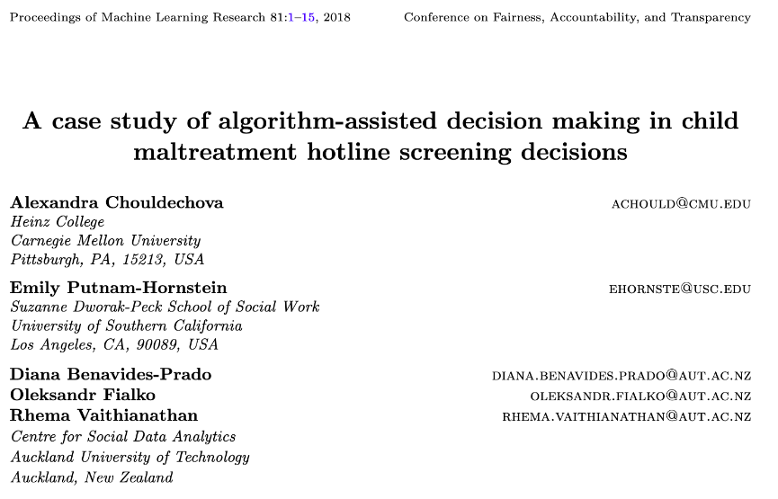
Child Welfare Case Study

Slide 49
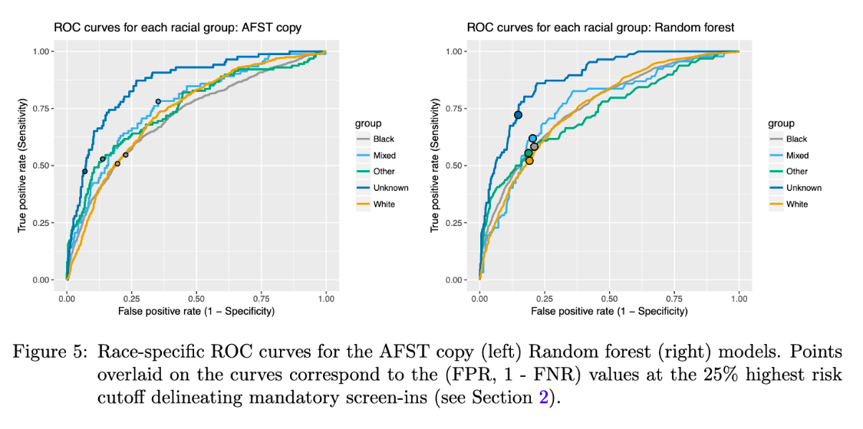
Child Welfare Case Study

Slide 50
Child Welfare Case Study
“We see that even though the ROC curves lie quite close to one another for most groups, the chosen threshold corresponds to different points on the ROC curves for different groups…. This FPR imbalance could lead to a perception that Mixed-race families are over- investigated relative to White families.
”

Slide 51
Bias and Fairness Workflow
Define
Understand (root causes)
Improve (fairness)
Measure/ Detect (bias)
Mitigate (the impact)
Monitor &
Evaluate
- Metrics(s)
- Groups
- Audit model(s) for bias across metric(s) and groups
Data
ML pipeline components
Actions
Pre-Processing
Modeling (e.g. regularization)
Post-processing
Design appropriate actions

Slide 52
Bias (in outcomes) can come from any of these four components
World
ML Pipeline
Actions
Data
Sample Bias
Measurement Bias
Label Bias
System Developers
Complexity or flaws
Design Choices

Slide 53
Bias and Fairness Workflow
Define
Understand (root causes)
Improve (fairness)
Measure/ Detect (bias)
Mitigate (the impact)
Monitor &
Evaluate
- Metrics(s)
- Groups
- Audit model(s) for bias across metric(s) and groups
Data
ML pipeline components
Actions
Pre-Processing
Modeling (e.g. regularization)
Post-processing
Design appropriate actions

Slide 54
Improving Fairness of Models
Pre-Processing: Try to fix the input data
In-Processing: Optimize for fairness in model training
Model Selection: Choose fair models during model selection
Post-Processing: Post-hoc adjustments to de-bias model scores

Slide 55
Fairness-aware Model Selection
0%
Performance Metric
100%

Slide 56
Fairness-aware Model Selection
100%
Bias
0%
Performance Metric
100%

Slide 57
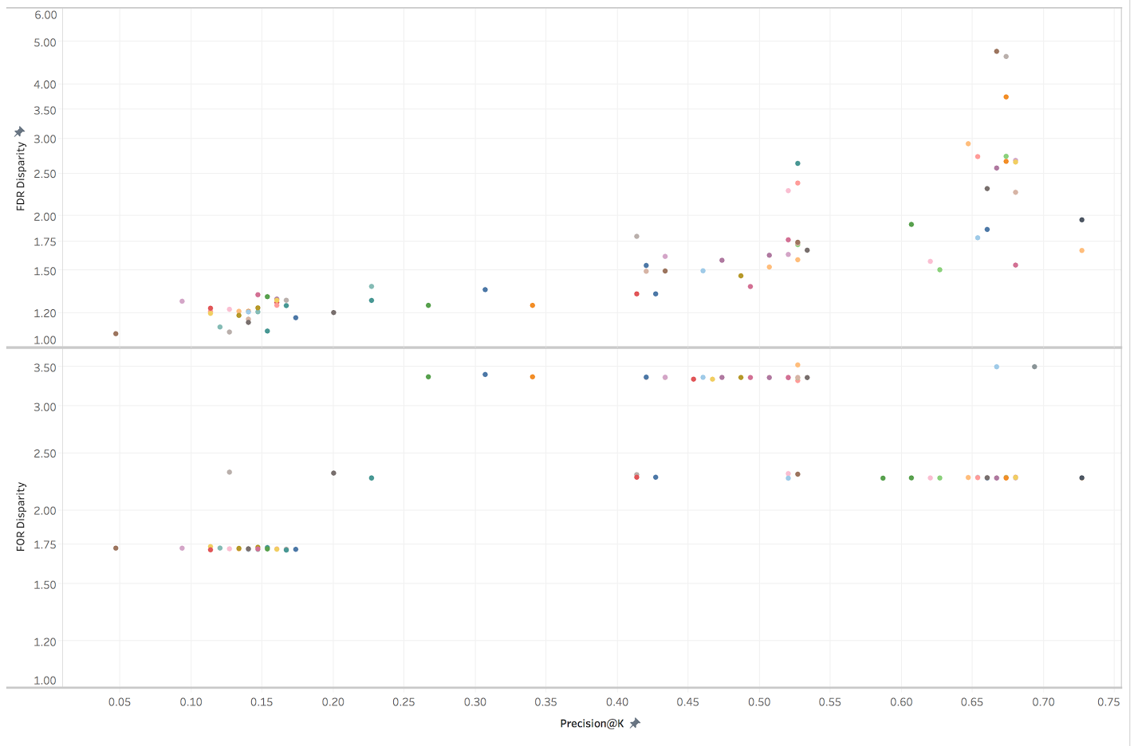
Fairness-aware Model Selection
Bias vs P@1% on Gender
False Discovery Rate Disparity
False Omission Rate Disparity
Precision at the top 1%

Slide 58
Improving Fairness of Models
Pre-Processing: Try to fix the input data
In-Processing: Optimize for fairness in model training
Model Selection: Choose fair models during model selection
Post-Processing: Post-hoc adjustments to de-bias model scores

Slide 59
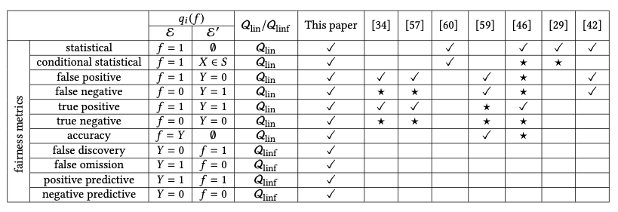
Optimize for Fairness in Model Training
General idea: modify optimization problem (for instance, by adding regularization terms to loss function) that account for fairness. Many implementations of different methods for various fairness metrics.

Slide 60
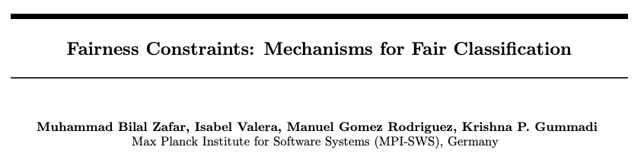
Optimize for Fairness in Model Training

Slide 61
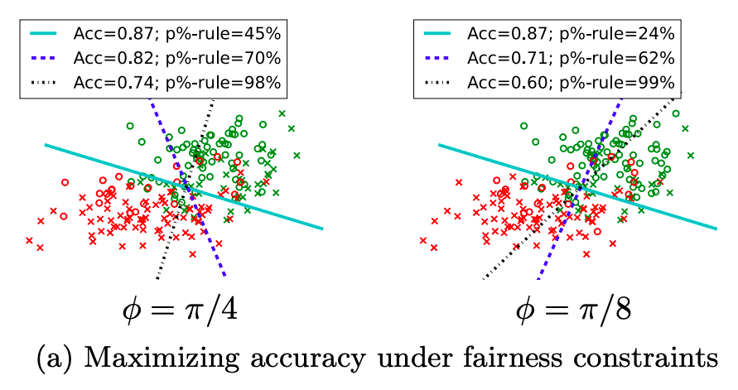
Optimize for Fairness in Model Training

Slide 62
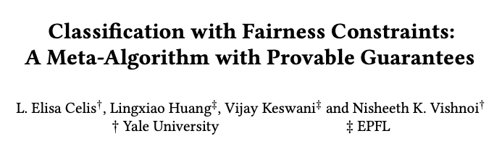
Optimize for Fairness in Model Training

Slide 63
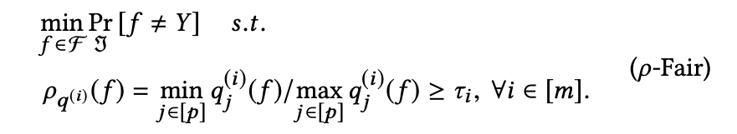
Optimize for Fairness in Model Training

Slide 64
Optimize for Fairness in Model Training
“group performance function”
capturing the equity metric
of interest

Slide 65
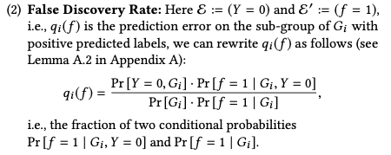
Optimize for Fairness in Model Training
for example:

Slide 66
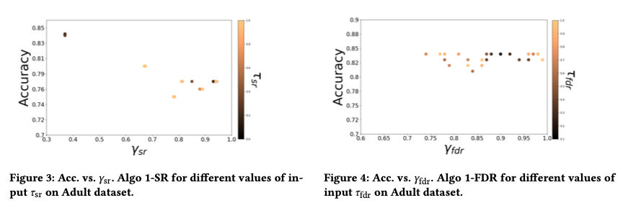
Optimize for Fairness in Model Training

Slide 67
Optimize for Fairness in Model Training: Advantages
Idea of an “all-in-one” solution is appealing
Provides some flexibility, especially when group membership not known exactly (e.g., gender estimated from name or race from census data)

Slide 68
Optimize for Fairness in Model Training: Limitations
Limited set of algorithms to do this directly, though also black-box options (often end up doing the same thing as post-hoc score adjustments)
Doesn’t preclude the need to auditing, assessment, and model selection – need to confirm the effectiveness of the constraint!
Generally don’t work well for “top k” problems off the shelf

Slide 69
Improving Fairness of Models
Pre-Processing: Try to fix the input data
In-Processing: Optimize for fairness in model training
Model Selection: Choose fair models during model selection
Post-Processing: Post-hoc adjustments to de-bias model scores

Slide 70
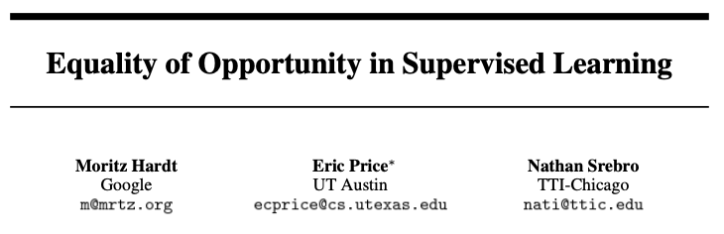
Post-hoc Adjustments

Slide 71
Post-hoc Adjustments
aka recall or TPR

Slide 72
Post-hoc Adjustments
“That is, to require that people who pay back their loan have an equal opportunity of getting a loan in the first place.
”

Slide 73
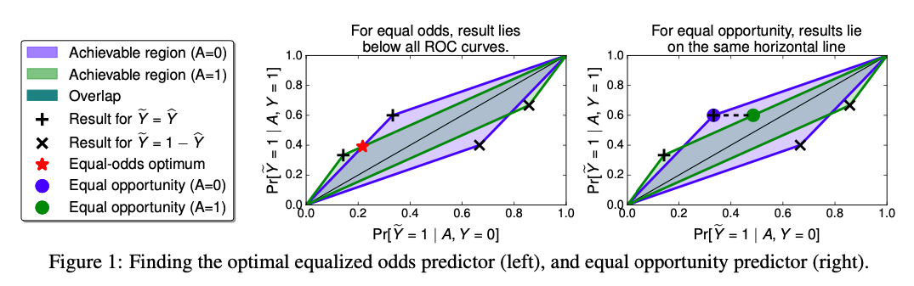
Post-hoc Adjustments

Slide 74
Case Study: Post-hoc Adjustments and Policy Goals
Cycle of Incarceration
UNMET
NEEDS
MISDEMEANOR
ARREST
JAIL
worsening or failing to improve

Slide 75
Case Study: Post-hoc Adjustments and Policy Goals
Breaking the Cycle
UNMET
NEEDS
X
MISDEMEANOR
ARREST
JAIL
TAILORED
INTERVENTION

Slide 76
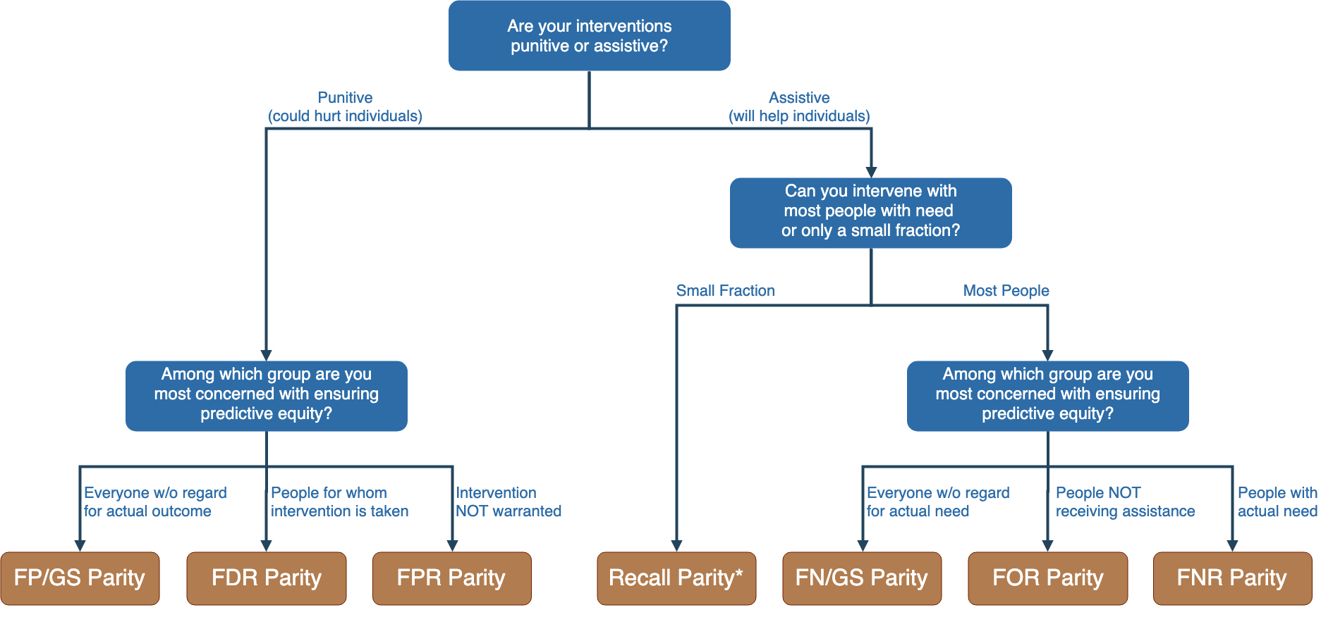
Notes:
Context-dependence of fairness definition
Idea of fairness tree is starting point for conversations with stakeholders, help guide discussion
In assistive program with resource constraints, focus on recall parity (equivalent to equality of opportunity discussed by Hardt and others --- also “sensitivity” and TPR and 1-FNR)

Slide 77
Notes:
Context-dependence of fairness definition
Idea of fairness tree is starting point for conversations with stakeholders, help guide discussion
In assistive program with resource constraints, focus on recall parity (equivalent to equality of opportunity discussed by Hardt and others --- also “sensitivity” and TPR and 1-FNR)

Slide 78
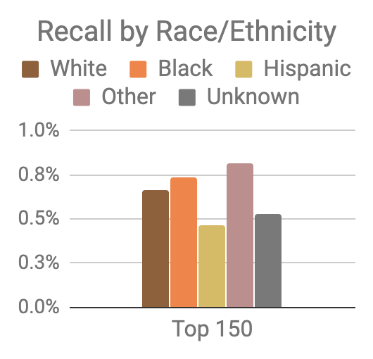
Model was optimized for efficiency, not equity
Top 150 highest risk reasonably balanced between black and white individuals
However, hispanic and unknown race/ethnicity groups very underrepresented

Slide 79
Mitigating Disparities
Single Threshold
White
Black
Hispanic
Recall
Lower Scores / Higher Recall
Group Thresholds
Recall

Slide 80
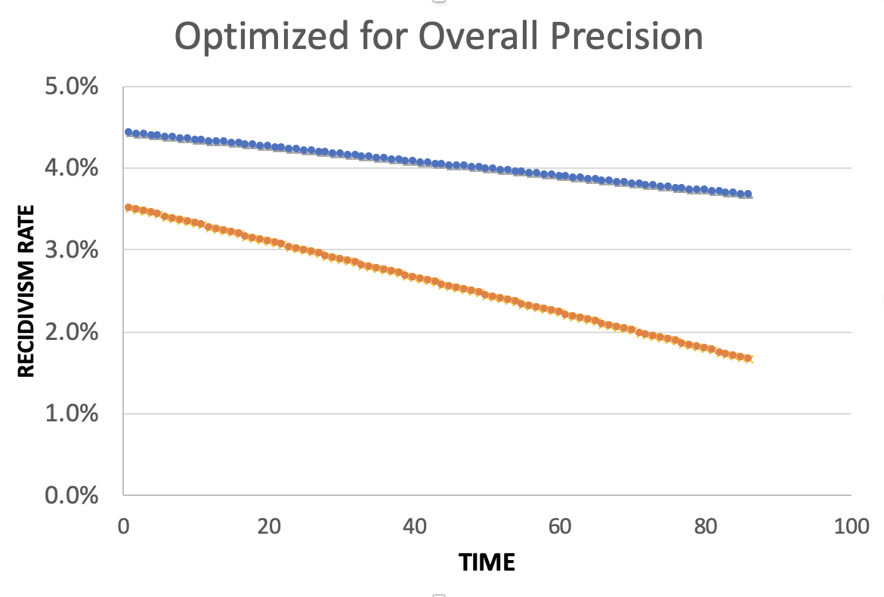
Equality of Predictions vs Underlying Disparities
Widening Gap:
Disparities Getting
Larger Over Time

Slide 81
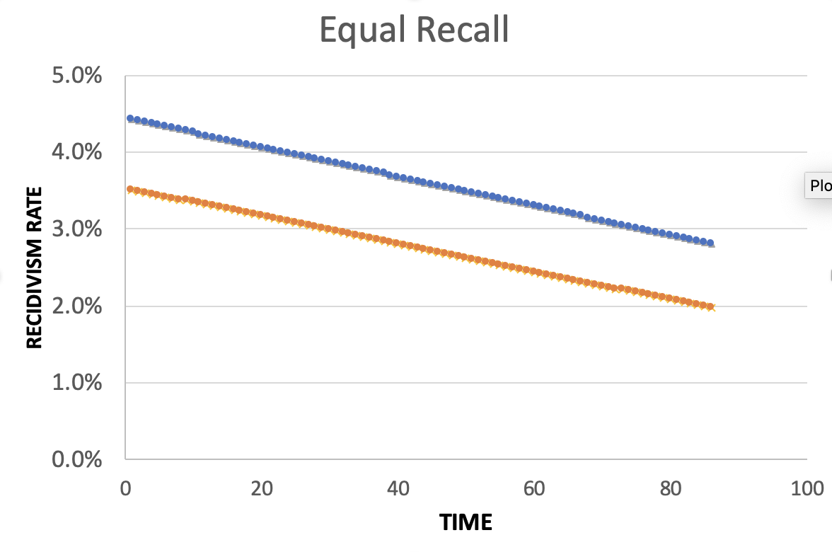
Equality of Predictions vs Underlying Disparities
Parallel Lines:
Disparities Remain
Constant Over Time

Slide 82
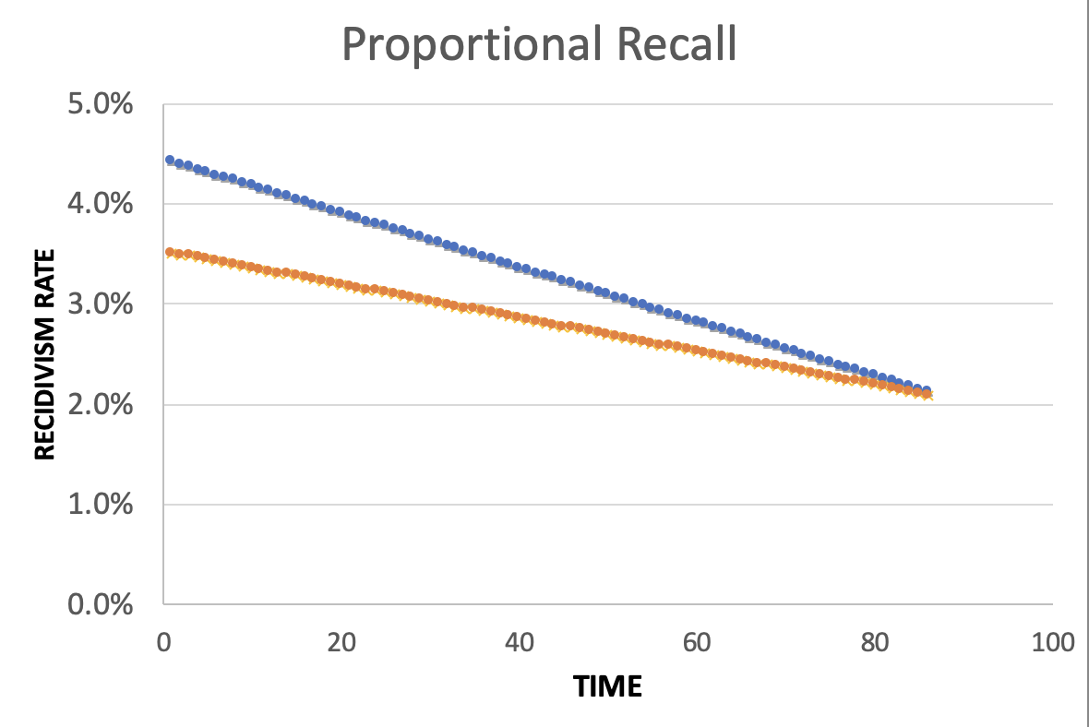
Equality of Predictions vs Underlying Disparities
Converging Lines:
Disparities Decrease
Over Time

Slide 84
Menu of Options
Current Scale
Expanded Scale
No
Constraint
Equalize
Recall
Reduce
Disparities

Slide 85
Menu of Options
Current Scale
Expanded Scale
No
Constraint
INITIAL
MODEL
Equalize
Recall
Reduce
Disparities

Slide 86
Menu of Options
Current Scale
Expanded Scale
No
Constraint
Equalize
Recall
EXPLICIT
EQUITY / EFFICIENCY
TRADE-OFF
“COST OF
EQUITY”
Reduce
Disparities

Slide 87
Menu of Options
Current Scale
Expanded Scale
No
Constraint
Equalize
Recall
IMPROVE OUTCOMES AT SAME
RATE ACROSS GROUPS
Reduce
Disparities
IMPROVE OUTCOMES FASTER FOR GROUPS
WITH HIGHER INCARCERATION RATES
Notes:
For the “Reduce Disparities” options, we targeted recall levels in proportion to underlying prevalence in the population. Could make other choices, but this has the nice property of readjusting as these prevalences change while also still distributing resources across all groups, but one could reasonably take many possible approaches.

Slide 88
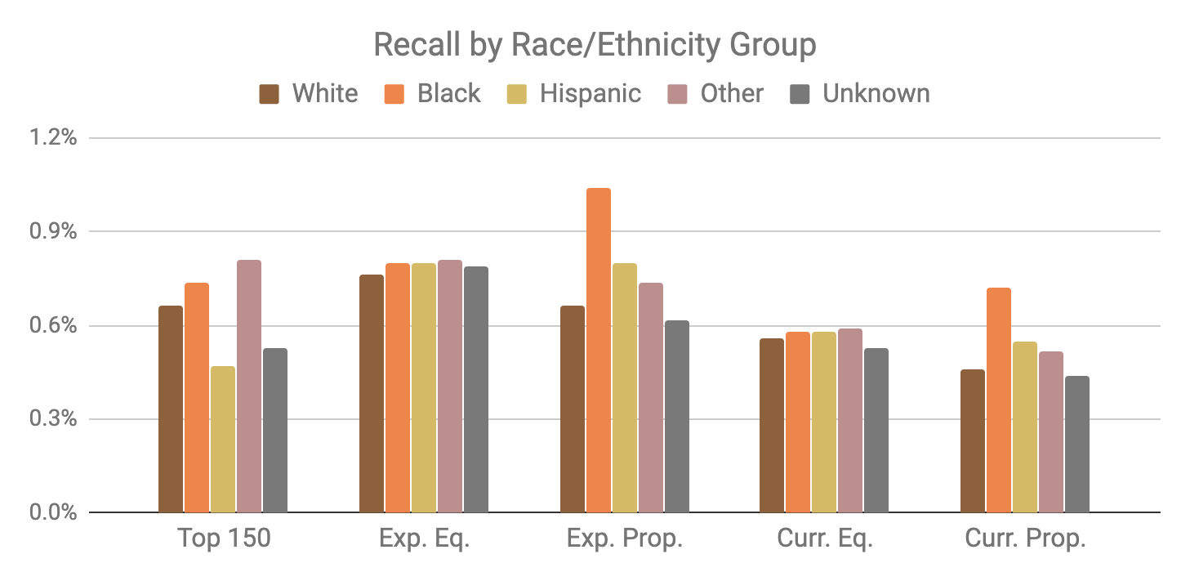
Base Model
Expanded Scale
Current Scale

Slide 89
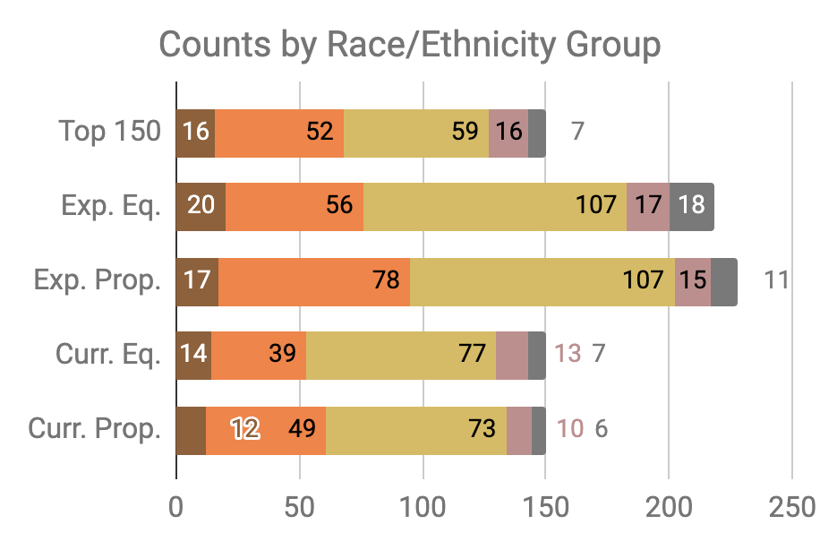

Slide 90
Little Equity/Efficiency Trade-Off at Current Scale
Top 150
72.7%
Precision
150
Total Count
Equal
Recall
70.7%
Precision
150
Total Count
Proportional
Recall
70.7%
Precision
150
Total Count

Slide 91
Improving Fairness of Models
Pre-Processing: Try to fix the input data
In-Processing: Optimize for fairness in model training
Model Selection: Choose fair models during model selection
Post-Processing: Post-hoc adjustments to de-bias model scores

Slide 92
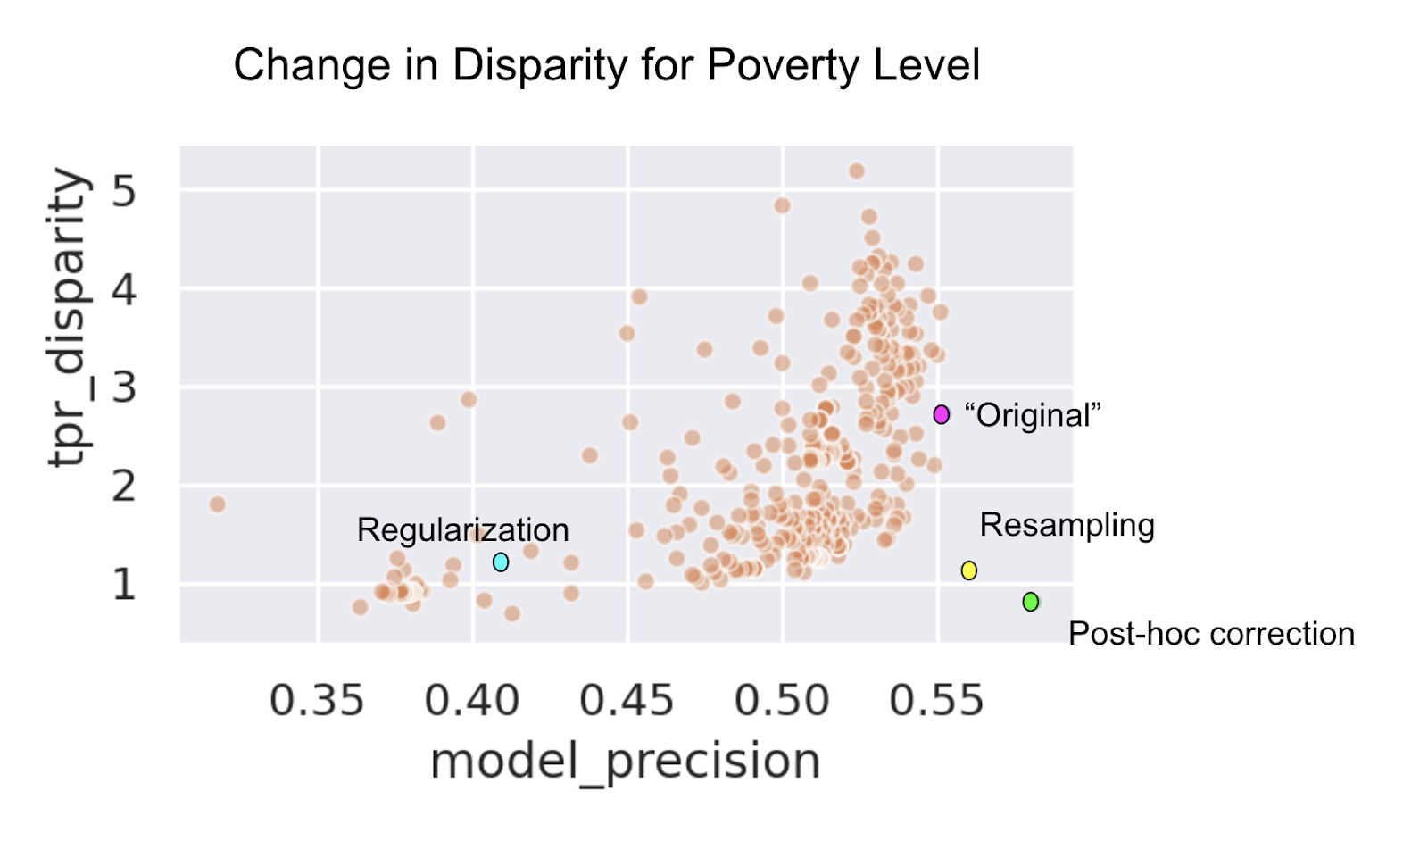

Slide 93
Data and AI Ethics Issues
Privacy
Data Ownership
Bias, Equity, & Fairness
Transparency
Trustworthiness and Accountability

Slide 94
Summary
Create an environment where informed ethical discussions can take place
Talk through ethical issues at each stage of the project (instead of waiting till the end of stopping after the initial setup)
Consider the entire chain of data - collection to analysis to action
Consider how it affects people throughout the chain – especially the people being affected (and include them in these discussions)
Embed ethics into both technical processes as well as people processes

Slide 95
Readings
Policy Paradox
Ethics and Data Science
Ethics and Policy in Data Science (Class at Cornell)
First, Do No Harm
FATML (workshops that have been happening for the past 4 years)

Slide 96
Useful resources we’ve created
Bias and Fairness in ML tutorial
Fairness Tree
Aequitas: Bias Audit Tool [description] [code]
Bias in ML Book Chapter

